Slide 1
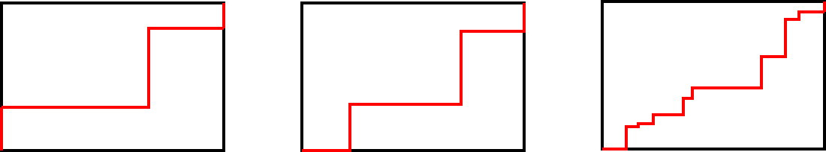

Perimeter with composite rectilinear shapes
Task A: Strange staircases
1) The perimeter of each rectangle is 26 cm.
How long is the red line each time?
a) b) c)
Justify your answer.
Task B: More composite rectilinear shapes
2
4
3
6
8
1) Try to rearrange these sides to create a rectangle.
Evaluate how easy this is to do.

Slide 2

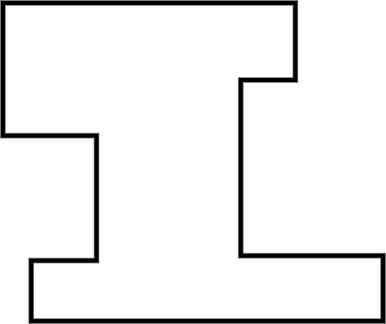
Perimeter with composite rectilinear shapes
Task C: Perimeter calculations
1) Calculate the perimeter.
a) b)
17
11.1 m
2
3.2 m
23
14
0.6 m
2
5
19
Mathematics in Education and Industry.

